Slide 1


Create Your Life-Changing To-Do List
With a website to-do list, you can crush your goals, stay organized, and make the most of your time. Follow our tips and choose the right tool, and soon you will be on your way to success!

Slide 2

The Benefits of a Website to-do List
1
Increased Productivity 📈
2
Better Organization 🗂️
3
Time Management ⏰
By breaking down tasks into smaller, manageable pieces, you can be more efficient and get more done.
A to-do list keeps everything in one place, so you don't have to constantly switch between different tools to track your progress.
By scheduling your tasks and setting due dates, you can prioritize what needs to be done and avoid wasting time on unimportant tasks.

Slide 3
Features of a Website to-do List
Task Creation and Management
Due Date Reminders
Priority Settings
Organize tasks by importance and stay focused on what matters most.
Create, assign, and edit tasks as needed. Track deadlines and keep an eye on progress.
Receive reminders when tasks are due, so nothing slips through the cracks.

Slide 4
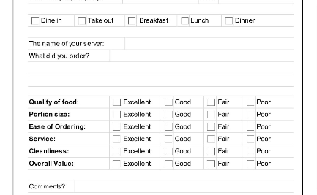

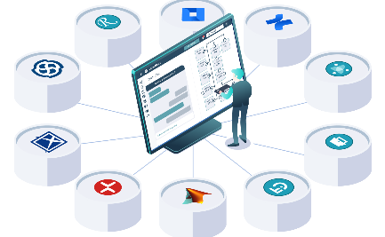
Choosing the Right Website to-do List Tool
User-Friendly Interface
Customization Options
Integration with Other Tools
A clean and easy-to-use interface helps you focus on your tasks rather than struggling with software.
Choose customizable icon sets, labels, and other features to make your to-do list personal and reflect your style and priorities.
Select a tool that integrates with your existing software to streamline your workflow and minimize interruptions.

Slide 5

Tips for Effectively Using a Website to-do List
1
Prioritize Tasks
Start with the most important tasks, and look for ways to delegate or outsource less important items.
Set Realistic Goals
2
Avoid being too optimistic, and focus on incremental progress. This can help you stay motivated and reach milestones as they emerge.
3
Regularly Review and Update the List
Don't let your to-do list become stale. Instead, review it regularly, update it as necessary, and keep it relevant to your current goals and projects.

Slide 6

Conclusion: Get Started with Your Website to-do List Today
Recap of Benefits and Features
Encouragement to Implement a Website to-do List
As a quick reminder, website to-do lists help you stay organized, focus on priorities, and boost productivity. Choose a tool that fits your needs and style.
Start small, establish a routine, and enjoy the sense of accomplishment that comes with completing tasks.

Slide 7
Bonus: The Power of a Growth Mindset
Don't forget that the key to success is not just having the right tools, but also having the right mindset. Embrace challenges, learn from mistakes, and stay curious. Your website to-do list is just one of the many steps on your path to growth!

